Slide 1
Why Do Loans Contain Covenants? Evidence from Lending Relationships
Robert Prilmeier
Tulane University
Journal of Financial Economics
April 2016
Presented by: Yan Li

Slide 2
Research Question:
How does relationship lending affect the use of loan covenants in a sample of large loans to publicly listed borrowers
How should control rights be distributed when relationship lenders acquire information about the borrower

Slide 3
Measures
Relationship intensity: the proportion of the firm’s loans over the previous five years that have been arranged by the current lender. A low level of relationship intensity implies that the current lender has not previously been the borrower’s main lender. A proxy for how well the lender knows the borrower relative to other lenders
Relationship duration: the duration of the borrower’s relationship with the current lender, a proxy for how well the lender knows the borrower in absolute terms

Slide 4

Measures
Covenant tightness: the average ex ante violation probability of a loan’s financial covenants
Covenant intensity: the number of financial covenants attached to a loan
Φ denotes the cumulative standard normal distribution function
Slack is measured using the difference between the financial ratio in the quarter prior to the loan start date and the covenant trigger.

Slide 5
Institutional background and covenant theories
Financial covenants as a monitoring device: Financial covenants require the borrower to maintain certain accounting measures of financial health, such as a minimum net worth or a maximum debt-to-EBITDA ratio.
Theories of covenant use:
Protection against information asymmetries:
to the extent that information asymmetries decline over the course of a lending relationship, covenants should become less restrictive.
this effect should be stronger for more opaque borrowers for whom ex ante information asymmetries are likely to be larger
Covenants as a monitoring incentive
The lack of monitoring incentives could subject the borrower to additional contracting costs. Since it makes the loan’s effective maturity contingent on monitoring, loan with covenants increases the bank’s benefits from monitoring relative to not monitoring

Slide 6
Data and measurement
Loan Pricing Corporation’s DealScan database: data on syndicated and large sole lender loans
Sample: 7,924 loans incurred by 3,171 U.S. borrowers between the years 1995 and 2008
Compustat: the borrowers’ accounting data

Slide 7
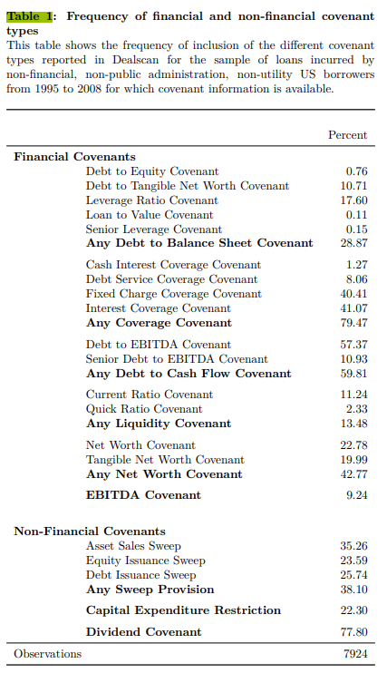
Covenant types
Sweep provisions require the borrowing firm to repay part or all of the loan prematurely if it takes certain actions such as, in the case of an asset sale sweep, selling assets in excess of certain allowances.

Slide 8
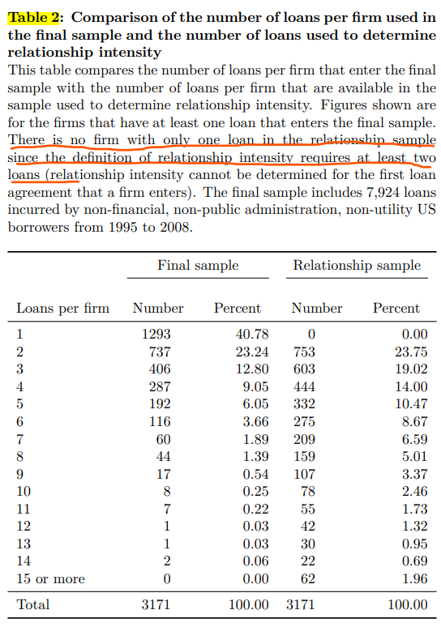
Data and Measurement
Table 2 shows the number of loans available per firm for the final sample and for the sample used to determine relationship intensity.

Slide 9
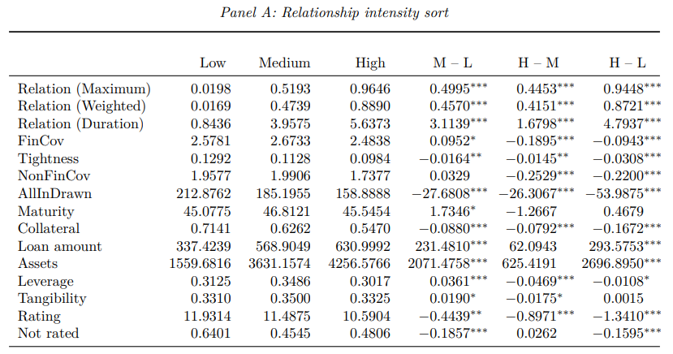
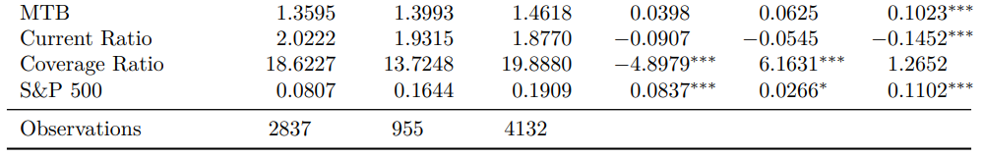
Data and Measurement
Loans are sorted on relationship intensity as measured by Relation (Maximum)
relationship intensity is “low” if relationship intensity is less than 30%, “high” if it is at least 70%, and “medium” if relationship intensity is between 30% and 70%.
Covenant tightness is lower for loans with high relationship intensity compared to those with low intensity.
Financial covenants increases from the low to the medium category and decreases from the medium to the high category.

Slide 10
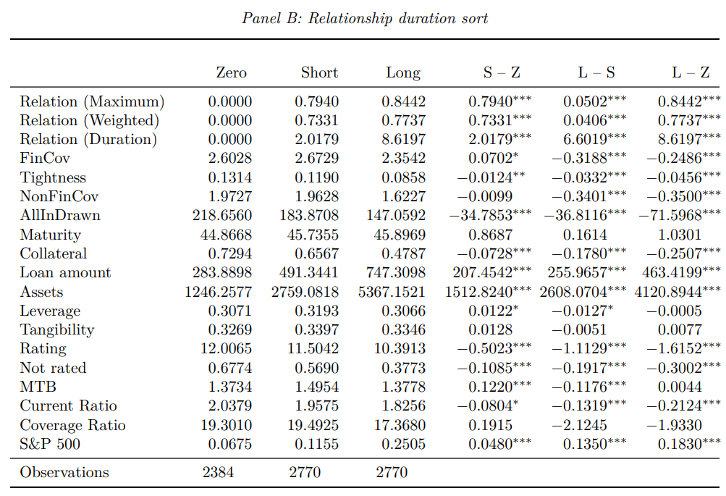
Data and Measurement
In Panel B, loans are sorted on relationship duration.
Column “Zero” shows loans with no prior relationship. The median relationship duration is 3.95 years.
Covenant tightness is lower for loans with long relationship duration than for non-relationship loans.
Covenant intensity is higher in short duration relationships than in loans with no previous relationship, but declines by from short duration to long duration relationships

Slide 11
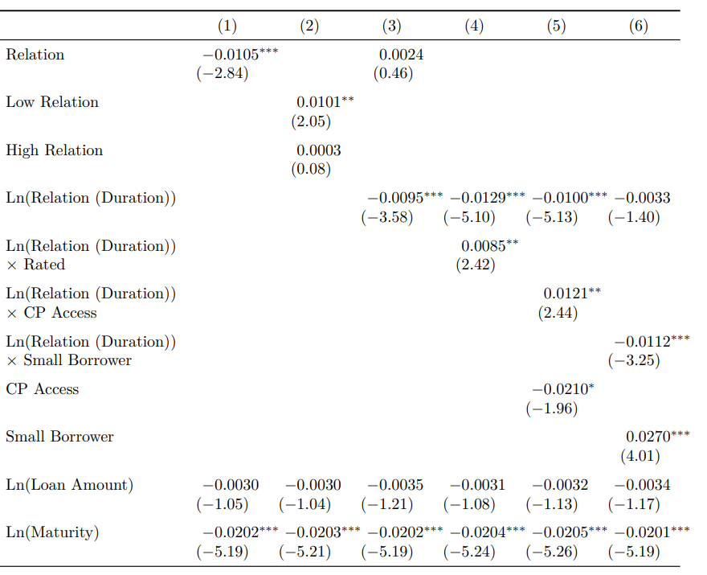
Regressions for covenant tightness
Tightness is negatively related to relationship intensity as measured by Relation (Maximum)
Loans with low relationship intensity have significantly tighter covenants than loans with medium relationship intensity
The decline in tightness appears to be driven by the duration of a lending relationship rather than relationship intensity
The decline in covenant tightness is concentrated in small, unrated borrowers and borrowers without access to the commercial paper market

Slide 12
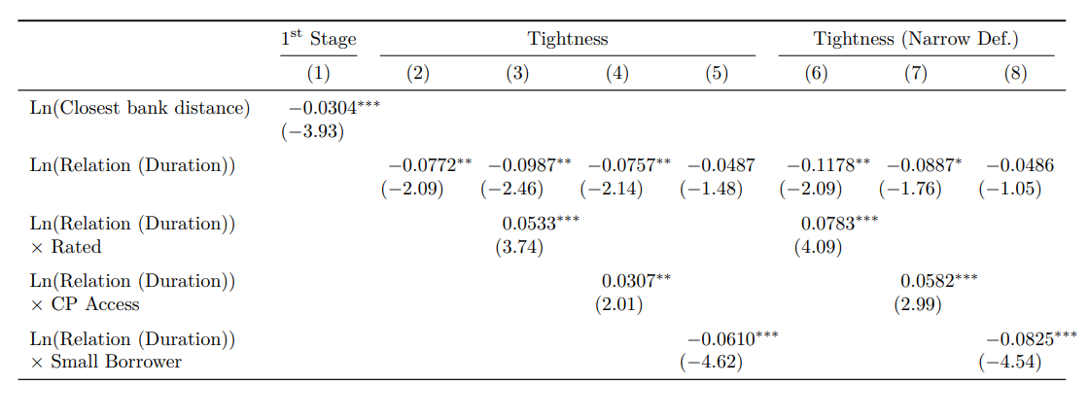
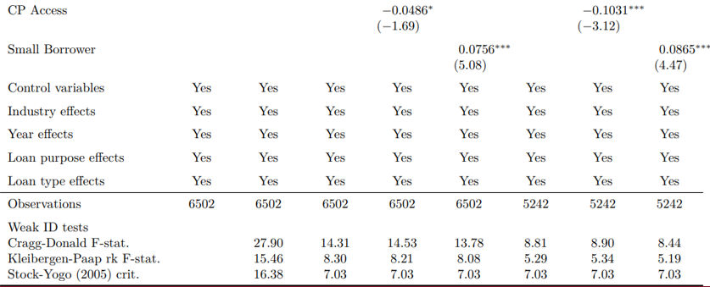
Regressions for covenant tightness
Borrowers that are located closer to a syndication active bank have significantly longer relationship duration.
IV: uses the distance between the borrower and the nearest syndication active bank
The reduction in covenant tightness is again concentrated in small, unrated borrowers that do not have access to the commercial paper market

Slide 13
Multiple regressions for covenant intensity
Poisson regressions

Slide 14
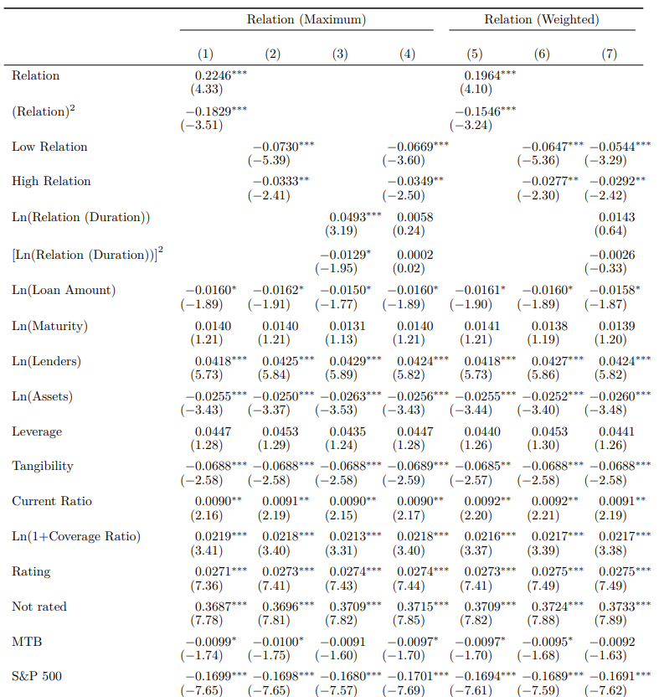
Multiple regressions for covenant intensity
The effect of both relationship intensity and relationship duration on financial covenant intensity appears to follow an inverted U shape
Both the low and high relationship dummies indicate a significantly lower covenant intensity compared to loans with medium relationship intensity
Covenant intensity appears to be driven by relationship intensity rather than relationship duration

Slide 15
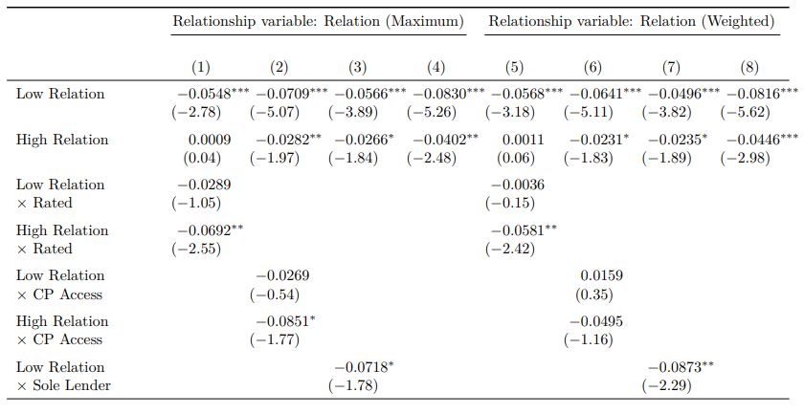
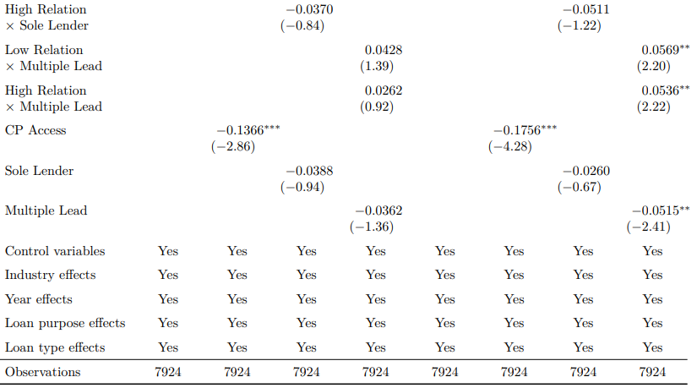
Multiple regressions for covenant intensity
the decrease in covenant intensity for firms in exclusive relationships is concentrated in rated firms and firms that have access to commercial paper
the difference in covenant intensity between a loan from a lender with little prior relationship and a loan from a medium intensity relationship lender is stronger for sole lender loans
the inverted U curve is flatter for loans with multiple lead arrangers ( positive significant numbers?)

Slide 16
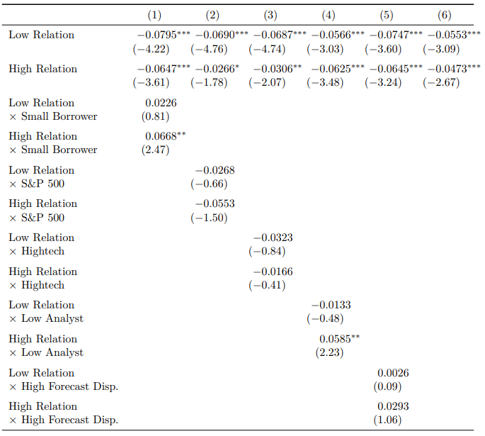
Multiple regressions for covenant intensity
the downward sloping part of the inverted U is stronger for large borrowers, borrowers with a large analyst following and borrowers whose stock is part of the S&P 500.
These results are consistent with the finding that the decrease in covenant count in exclusive relationships is driven by borrowers with better access to capital markets.

Slide 17
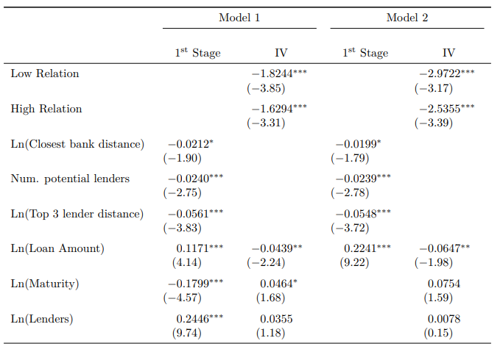
Multiple regressions for covenant intensity
Instruments:
the distance between the borrower and the nearest syndication active bank
the number of syndication active banks within a one hundred mile radius around the borrower’s headquarters at the time the loan is made
the distance between the borrower and the nearest syndication active bank with high capacity
Model (2) omits the potentially endogenous variables maturity and syndicate size from the ordered probit.
The instruments continue to negatively predict relationship intensity.
Same results: There’s a decline of the number of covenant use for both low and high relationship intensity

Slide 18
Multiple regressions for covenant intensity
Investigates whether the effect of relationship intensity on covenant use holds after accounting for the price-covenant trade-off (more covenants, lower interest rate)
I_{i} equals one if the loan includes more than two financial covenants (the sample median) and zero otherwise
(y_{lowcov,i} − y_{highcov,i}): yield spread
λ captures the extent to which borrowers are more likely to include the covenant when the resulting yield spread reduction is large
The vector Z_{i} contains other determinants of covenant choice

Slide 19
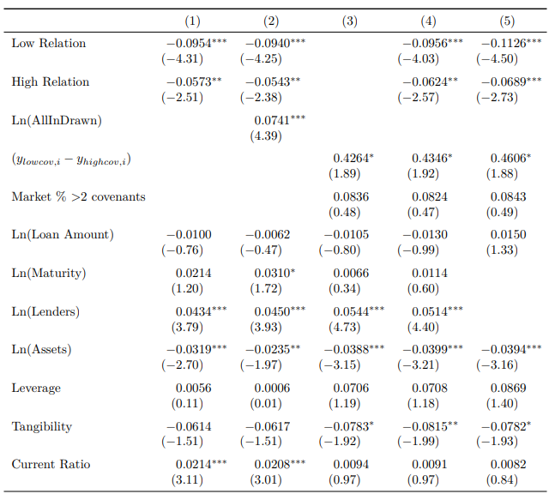
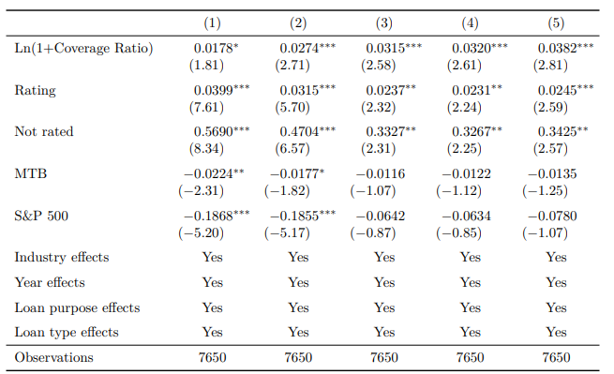
Multiple regressions for covenant intensity
After accounting for the price-covenant trade-off:
Medium relationship intensity loans are 9.5% more likely to have more than two financial covenants than low relationship intensity loans. High intensity loans are 5.7% less likely to have more than two financial covenants than medium intensity loans.
The positive coefficient of the log of the all-in drawn spread suggests that loans with a high covenant load are riskier on average.
the predicted difference in yield spread is a positive predictor of high covenant load. Adding this variable has little effect on the relationship terms

Slide 20
Conclusions
Consistent with the information asymmetry theory of covenant use, covenant tightness monotonically decreases over the duration of a lending relationship, especially if borrowers are opaque.
Relationship intensity has an inverted U effect on the number of covenants included in a loan, such that the firm’s main relationship lender receives more covenants than other lenders, unless the relationship is exclusive
Covenants’ role as monitoring incentives can be a potential explanation for the increase in covenant intensity in lending relationships. The increase in covenant intensity in a lending relationship is stronger for sole lender loans and loans with only one lead arranger, for which covenants can be expected to be more effective in creating monitoring incentives
There’s no evidence that the effect of relationship status on covenant count is linked to ex ante lock-in effects or information asymmetries.

Slide 21
Marginal Contributions to Literature
This paper contributes to the growing literature on why debt contains covenants.
This paper also contributes to the large literature on lending relationships. this paper is the first to investigate the effect of relationship intensity on covenant use
the paper adds to the finding of Demiroglu and James (2010) that covenant tightness contains private information about the firm’s prospects, but covenant intensity does not

